Slide 2
“Information extraction is the identification, and consequent or concurrent classification and structuring into semantic classes, of specific information found in unstructured data sources, such as natural language text, providing additional aids to access and interpret the unstructured data by information systems.”
[Moens 2006]

Slide 3
Fact extraction

Slide 4
= particular type of information extraction, focusing on factual information
fact = actual occurrence

Slide 5
Why do we need IE?
Huge amounts of unstructured data in a variety of media, languages and other formats
Need for the machine to help:
  Retrieval and searching
  Mining
  Summarizing and synthesis

Slide 6
Named entity recognition
Boeing, Airbus vie for Qantus contract
December 4, 2005: 12:19 AM EST
SYDNEY (Reuters) - Qantas Airways Ltd., which will seek board approval this week to spend up to A$20 billion ($15 billion) on new planes, said on Sunday the contest between rival manufacturers was the closest it has seen.
Planemakers Boeing and Airbus are set to end a record year for new plane orders with a decision from Australia's Qantas, which has said it might need as many as 100 new planes.
Qantas chief executive Geoff Dixon said management had not decided on a final recommendation for Wednesday's board meeting, but fleet renewal was essential for the carrier, which also wants to expand its low-cost Jetstar airline internationally …

Slide 7
Noun phrase coreference resolution
Clinton was the third-youngest president, behind Theodore Roosevelt (the youngest president) and John F. Kennedy (the youngest to be elected president). He was the first baby boomer president. ...
The husband of Hillary Clinton ...

Slide 8
Relation recognition
Motorola, Inc. announced that the company and General Instrument Corporation completed their previously announced merger following GIC shareholder approval at a special meeting held Wednesday.

Slide 9
Event detection and linking
Breaking: Microsoft Withdraws Yahoo Bid; Walks Away From Deal (Updated)
Michael Arrington
Microsoft will announce shortly that they have withdrawn their offer to acquire Yahoo. Talks between the two companies and their advisors broke down earlier today, according to a source close to Microsoft, after a failure to come to agreement on price and other terms. ...
...
REDMOND, Wash., May 3, 2008 Microsoft Corp. (NASDAQ: MSFT) today announced that it has withdrawn its proposal to acquire Yahoo! Inc. (NASDAQ: YHOO).ﾒWe continue to believe that our proposed acquisition made sense for Microsoft, Yahoo! and the market as a whole. Our goal in pursuing a combination with Yahoo! was to provide greater choice and innovation in the marketplace and create real value for our respective stockholders and employees,ﾓ said Steve Ballmer, chief executive officer of Microsoft. ...
June 3: During a legal action against the Yahoo board for its alleged failure to act in shareholders' interest, documents reveal that Yahoo's management drew up plans to reject a Microsoft takeover three months before the $45bn offer was made. ...
REDMOND, Wash., May 3, 2008 ﾑ Microsoft Corp. (NASDAQ: MSFT) today announced that it has withdrawn its proposal to acquire Yahoo! Inc. (NASDAQ: YHOO).ﾒWe continue to believe that our proposed acquisition made sense for Microsoft, Yahoo! and the market as a whole. Our goal in pursuing a combination with Yahoo! was to provide greater choice and innovation in the marketplace and create real value for our respective stockholders and employees,ﾓ said Steve Ballmer, chief executive officer of Microsoft.ﾒDespite our best efforts, including raising our bid by roughly $5 billion, Yahoo! has not moved toward accepting our offer. After careful consideration, we believe the economics demanded by Yahoo! do not make sense for us, and it is in the best interests of Microsoft stockholders, employees and other stakeholders to withdraw our proposal,ﾓ said Ballmer.

Slide 10

Sharapova beats Ivanovic to win Australian Open
A year after being on the wrong end of one of Russian didn't drop a set in seven matches at Melbourne Park, including wins the most-lopsided losses in a Grand Slam final, Sharapova wrapped up her third major title with a 7-5, 6-3 victory over fourth-seeded Ana Ivanovic on Saturday.The 20-year-old over three of the top four ranked players, erasing 12 months worth of painful memories in the wake of her 6-1, 6-2 loss to Serena Williams last year.After Ivanovic sprayed a forehand wide on match point, Sharapova dropped to her knees and appeared to be fighting back tears as she waved and blew kisses to the crowd.Then she dropped her racket in her chair before heading to shake hands and exchange high-fives with her father and supporters.
Australian Open won by Maria Sharapova
Great victory!
Location: Melboune Park
Tennis 2008
Sports
Date: Fri, 25 Jan 2008 11:21:15 +0100 (CET)
From: Maarten Logghe <maarten@yoru.be>
To: Sien Moens <sien.moens@cs.kuleuven.be>
Subject: Re: Op zoek naar een medewerker
Hoi Sien,
Ik vrees dat je nog wat verder zult moeten zoeken... ik kan het niet doen
en ik heb wat rondgevraagd bij vrienden en ex-collega's enzo maar helaas..
veel succes,
maarten
Declining job offer
Non-spam
L’é tro bel cet voitur Voici tt ce ki me pasione ds ma petite vi!!!é tt mé pote é pl1 dotre truk!!!Avou de Dcouvrir
Positive sentiment

Slide 11
Information extraction: more examples
Extraction of details of an event:
  e.g., type of event, time, location, number of victims, symptoms of a disease, etc.
Extraction of information on Web page:
  e.g., e-mail, date of availability of a product, …
Extraction of opinions on certain topic
Extraction of scientific data from publications:
  e.g., localization of a gene, treatment of a disease, function of a gene,...
See PART 5
AND NOT ONLY TEXT !!!

Slide 12
Information extraction from text
Discipline in between NLP and IR in terms of difficulty and emphasis:
  NLP: theoretical basis: description of structural properties of language:
    syntactic, semantic and conceptual structure
    features, classification scheme
  IR: theoretical basis: mainly statistics and probability theory
Tested in ARPA’s Tipster Text Program and in the past Message Understanding Conferences (MUC), Automatic Content Extraction (ACE) and current Text Analysis Conference (TAC) (National Institute of Standards and Technology, NIST)

Slide 13
Role of natural language processing
Object of study = text written in natural language
Number of properties (features, attributes) that can be exploited
  Lexical features
  Morpho-syntactic features
  Semantic features
  Discourse features

Slide 14
Lexical features
Tokenization = converting input stream of characters into a stream of words or tokens
  space-delimited languages (most European languages):
    word = string of characters separated by white space
  unsegmented languages (e.g., Chinese, Thai, Japanese):
    e.g., use of a word list (MRD = machine-readable dictionary)

Slide 15
Lexical features
Difficulties:
  1. use of special characters:
    e.g., period in abbreviation can be confused with words that end with a full stop at the end of sentence
    apostrophes
    hyphens
    => need for language specific rules
  2. normalization of numbers

Slide 16
Lexical features
Use of a finite state automaton or finite state machine:
  often integrates:
    transformations (e.g., case of letters, abbreviations and acronyms)
    removal of stopwords (caution!)

Slide 17
Morphological transformations
Lemmatization = finding the lemma or lexeme of an inflected word form (the lemma is the canonical dictionary entry form of the word)
Lookup of terms and their lemma in a machine-readable dictionary (MRD):
    correct (e.g., ponies -> pony)
    often large lists that need to be searched efficiently
    not always available or not all words covered

Slide 18
Morphological transformations
Stemming = reducing the morphological variants of the words to their stem or root
Affix removal algorithms:
  language dependent rules to remove suffixes and/or prefixes from terms leaving a stem
  possible language dependent transformation of the resulting stem
  examples:
    Lovins stemmer (1968)
    Porter algorithm (1980)

Slide 19
POS tagging and sentence parsing
Part-of-speech (POS) or syntactical word class:
  contributes to the meaning of the word in a phrase
  distinct component in syntactic structure
  content words: nouns, adjectives, verbs, adverbs
  function words: have functional properties in syntactic structure: act as determiners, quantifiers, prepositions and connectives (e.g., articles, pronouns, particles, …)

Slide 20
POS tagging and sentence parsing
Parse features:
  Path: describes the path through the parse tree from the current word to the position of the predicate (verb), e.g., NNP↑NP↑PP↑NP↑S↓VP↓VBG:
    ↑= indicates going up one constituent
    ↓= indicates going down one constituent
  Split Path: the path feature causes an explosion of unique features: reduced by splitting the path in different parts and use every part as a distinct feature: e.g.: split of the above path in different features: NNP; ↑NP; ↑NP;↑PP; ↑S; ↓VP; ↓VBG

Slide 21
Other natural language features
Semantic features: e.g., from lexico-semantic resources, obtained in previous extraction tasks
Discourse features: e.g., discourse distance
And features typical for digital documents: e.g., HTML tags
These features describe the information unit to be classified and its context

Slide 22
The role of machine learning
Major advances in pattern classification today:
  Classification of objects (e.g., images, text, ...) into a number of categories:
    => recognition of content
  Many of the techniques involve machine learning and statistical classification

Slide 23
Supervised learning
Techniques of supervised learning:
  training set: example objects classified by an expert or teacher
  detection of general, but high-accuracy classification patterns (function or rules) in the training set based on object features and their values
  patterns are predictable to correctly classify new, previously unseen objects in a test set considering their features and feature values

Slide 24
Supervised learning
  Text classification can be seen as a:
    two-class learning problem:
      an object is classified as belonging or not belonging to a particular class
      convenient when the classes are not mutually exclusive
    single multi-class learning problem
  Result = often probability of belonging to a class, rather than simply a classification

Slide 25
Unsupervised learning
Techniques of unsupervised learning :
  natural groupings of similar objects are sought based object features and their values
  often use of simple hard and fuzzy clustering techniques

Slide 26
Weakly supervised learning
Techniques of weakly supervised learning
  supervised learning starting from a limited set of classified seed objects
  exploit knowledge from set of unlabeled examples
  often iterative learning until results on validation set cannot anymore be improved
  E.g., self-training, co-training

Slide 27
Information extraction
Classification scheme = semantic labels and their relationships (external knowledge)
  Domain-independent: e.g., coreferent relations
  Domain-dependent: e.g., biomedical name classes
  Form:
    list
    hierarchy
    binary scheme
    ontology, labels can have relationships (e.g., hierarchically organized)

Slide 28
Evaluation: confusion matrix
Column: gives number of instances classified by system in the specific class
Row: gives number of instances classified by expert in the specific class
Easy to see if system confuses two classes
Built for binary and multi-class classification problems

Slide 29
Evaluation: confusion matrix
Confusion matrix of binary classification decisions (e.g., for intrinsic evaluation of e.g., text categorization, information extraction, classification in relevant - non-relevant documents):
System says yes System says no
Expert says yes tp fn
Expert says no fp tn
where
tp = true positives fn = false negatives
fp = false positives tn = true negatives

Slide 30
Evaluation: confusion matrix
    recall = tp / (tp + fn)
    precision = tp / (tp + fp)
    error rate = (fp + fn) / (tp + fp +fn + tn)
    accuracy = (tp + tn) / (tp + fp +fn + tn)

Slide 31
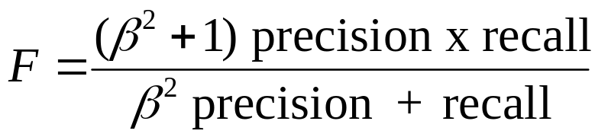
Evaluation: F-measure
F-measure: combines recall and precision
  where
  β = a factor that indicates the relative importance of recall and precision
  ideally close to 1
  when β = 1: also called harmonic mean= F₁

Slide 32
The symbolic approaches

Slide 33
The symbolic approaches
Symbolic approaches rely on symbolic handcrafted knowledge
  drafted by a knowledge engineer, possibly helped by expert
  based on moderate-sized corpus that is manually inspected
Intuitive approach for extracting information from natural language texts

Slide 34
FMLN terrorists in retaliation for recent arrests attempted to kill 5 policemen with car bombs.
Task: to extract : the perpetrators (FMLN terrorists), the victims (5 policemen) and the weapons (car bombs).
The following extraction patterns would do the job:
    <perpetrator> attempted to kill
    <subj> verb infinitive
    attempted to kill <victim>
    verb infinitive <obj>
    to kill with <weapon>
    infinitive prep <np>

Slide 35
Early origin
° end 1960s and 1970s: Schank:
  defines all natural language words in terms of elementary primitives or predicates in an attempt of capturing the semantic content of a sentence
  conceptual dependency representation specifies semantic roles: the action of the sentence (e.g., as reflected by the verbs of the text) and the arguments (e.g., agent, object) and circumstances
  representations are ordered in a script, which outlines sequences of events or actions

Slide 36
  Sentence:
  Martin goes to Brussels.
  will be graphically represented in CD theory as follows:
  Brussels
  Martin ⇔ PTRANS Martin
    XX
  meaning that Martin performs the act of changing the location (PTRANS) of Martin from an unknown location (indicated by XX) to Brussels
  where O and D indicate an objective and a directive relationship respectively
O
D

Slide 37

Script: human (X) taking the bus to go from LOC1 to LOC3
1. X PTRANS X from LOC1 to bus stop
2. bus driver PTRANS bus from LOC2 to bus stop
3. X PTRANS X from bus stop to bus
4. X ATRANS money from X to bus driver
5. bus driver ATRANS ticket to X
6.
7. bus driver PTRANS bus from bus stop to LOC3
8. X PTRANS X from bus to LOC3
(3), (7), (8): mandatory
[Schank 1975]
X gives money to the bus driver. ATRANS is used to express a transfer of an abstract relationship, in this case the possession of money.
Various subscripts handling actions possible during the ride.

Slide 38
Frame-based approaches
[Minsky 1975]: frame-based knowledge representations
  frames are often triggered by the occurrence of a certain word or phrase
  very partial analysis of the input text:
    algorithm tries to match natural language sentences with particular frames by simply filling out the slots in accordance with the constraints placed on them
    often top-down (expectation-driven): guided by the expected patterns to be found in the text
    robust: ignoring of irrelevant information
  template frames that outline the information can be used as output

Slide 39
Frame-based approaches
Implementation:
  Linguistic preprocessing of the text:
    POS tagging, parsing, named entity recognition, ...
  Mapping of the frames to the texts :
    feature slots: labels, fixed for a particular frame
    feature values: fill the slots with extracted information, certain constraints can be placed
  Frames can be connected in a semantic net
    advantages:
      default values, inherited values

Slide 40
Frame-based approaches
  Patterns to be identified can be encoded as regular expressions and recognized by finite state automaton
  Frames are often organized in a script:
    because of their strict organization, scripts have good predictive ability useful in information extraction

Slide 41
Frame-based approaches
Examples of some famous information extraction applications:
    FRUMP (DeJong, 1982): Yale University
    FASTUS (Hobbs et al., 1996): Stanford Research Institute

Slide 42
FASTUS
Finite state automaton implementation: set of cascaded, non-deterministic finite-state transducers
  application of symbolic rules in the form of hand-crafted regular expressions
  cascade: output of finite state transducer is input for next finite state transducer
[Hobbs et al. IJCAI 1993] [Hobbs JBioInformatics 2002]

Slide 43
Cascade of finite state transducers
1
Recognition of compound words and named entities
2. Partial parse: recognition of verb, noun, prepositional phrases, actives, passives, gerunds
2
3
3. Recognition of complex noun groups
4. Resolution to active form, recognition of information to be extracted
4
5. Structure merging
5

Slide 44
Example sentence:
  Bridgestone Sports Co. said Friday it has set up a joint venture in Taiwan with a local concern and a Japanese trading house to produce golf clubs to be shipped to Japan.

Slide 45
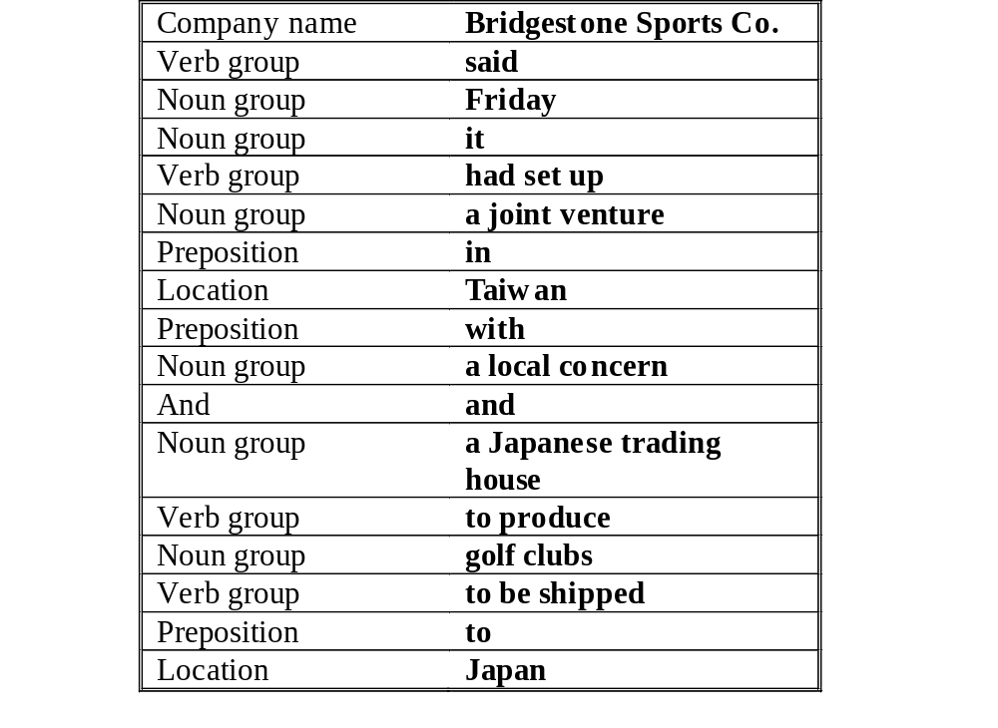
Step 2

Slide 46
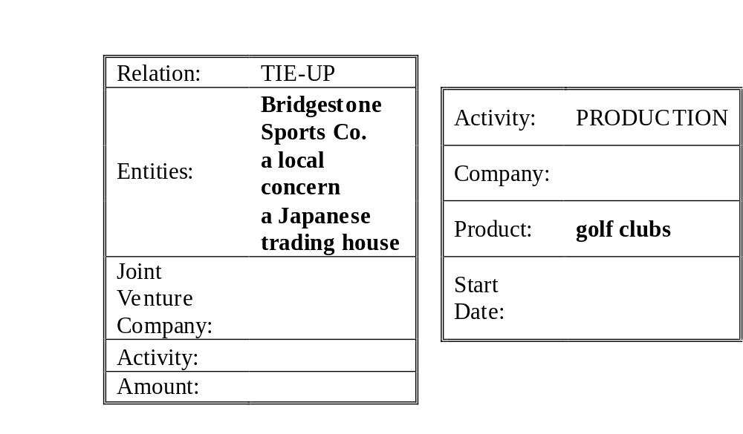
Step 4
  Extraction rules:
  <Company/ies> {Set-up} {Joint-Venture} {with} <Company/ies>
{Produce} <Product>

Slide 47
Symbolic techniques: results
Successful systems, built and tested in many subject domains
e.g., MUC-7 (1998): subject domain of air plane crashes:
  performance of individual systems: largely similar
  certain information much easier to extract than others
Problem:
  infinite variety of subject domains: very difficult to exhaustively implement the symbolic knowledge
  very difficult to construct a script for every conceivable situation

Slide 48
What to learn from the symbolic techniques?
They are very useful in case:
  the knowledge can be easily manually crafted
  the knowledge is stable and can be used in many applications
  the knowledge patterns are unambiguous
  Examples:
    syntactic reformulation rules
    rules for stemming

Slide 49
Problem
Symbolic techniques are useful in very restricted subject domains that exhibit standard patterns:
  e.g., mining of a weather report
In most settings language is characterized by:
  a variety of patterns that express the same or similar meanings
  ambiguous patterns that receive their meaning based on the context
Patterns change in time (e.g., blog and chat languages)

Slide 50
Problem
manual effort is huge to build all the needed (contextual) patterns for all kinds of information extraction tasks
IE in terrorism domain: experiment of Riloff (1996): automatic construction of dictionary of extraction patterns from an annotated training corpus achieved 98% of the performance of handcrafted patterns
  => machine learning of extraction patterns
[Riloff AI 1996]

Slide 51
Problem
Since 1996: interest in machine learning for information extraction:
  Usually supervised learning algorithms:
    e.g., learning of rules and trees, support vector machines, maximum entropy classification, hidden Markov models, conditional random fields
  Unsupervised learning algorithms:
    e.g., clustering (e.g., noun phrase coreferent resolution)
  Weakly supervised learning algorithms

Slide 52
Markov model
The model of the content is implemented as a Markov chain of states
The model is defined by:
  a set of states
  a set of transitions between states and the probabilities of the transitions (probabilities of the transitions that go out from each state sum to one)
  a set of output symbols å that can be emitted when in a state (or transition) and the probabilities of the emissions

Slide 53
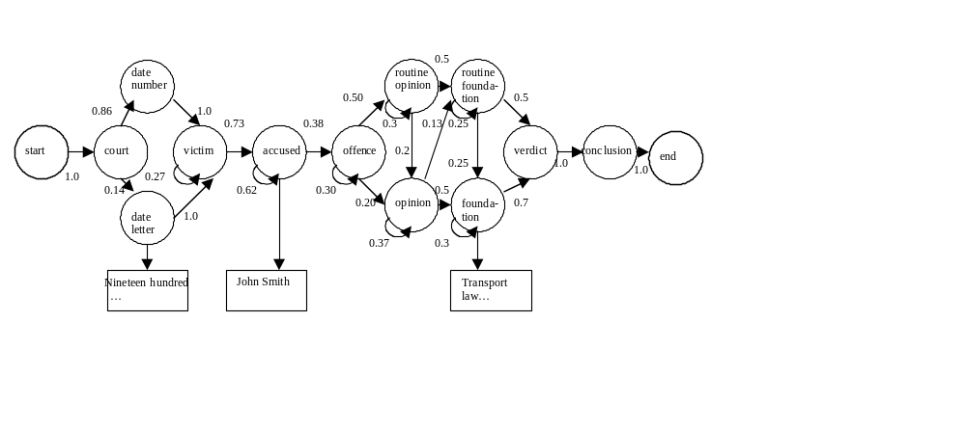

Slide 54
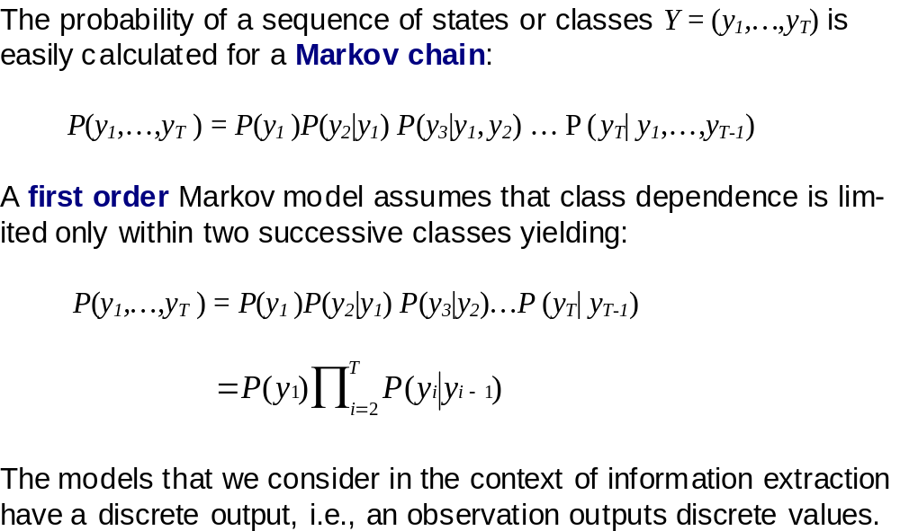

Slide 55
Markov model
So, using the first-order Markov model in the above example gives:
  P(start, court, date number, victim) = 0.86
When a sequence can be produced by several paths: sum of path probabilities is taken.

Slide 56
Markov model
Visible Markov model:
  we can identify the path that was taken inside the model to produce each training sequence: i.e., we can directly observe the states and the emitted symbols
Hidden Markov model:
  you do not know the state sequence that the model passed through when generating the training examples, i.e., the states of the training examples are not fully observable

Slide 57
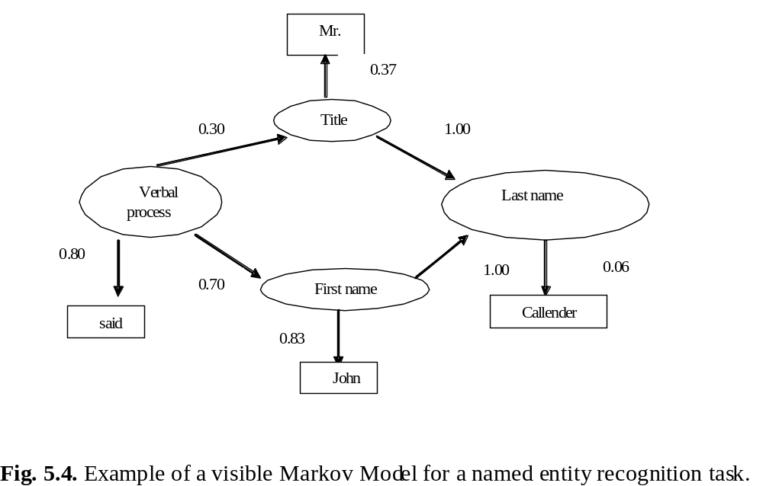

Slide 58
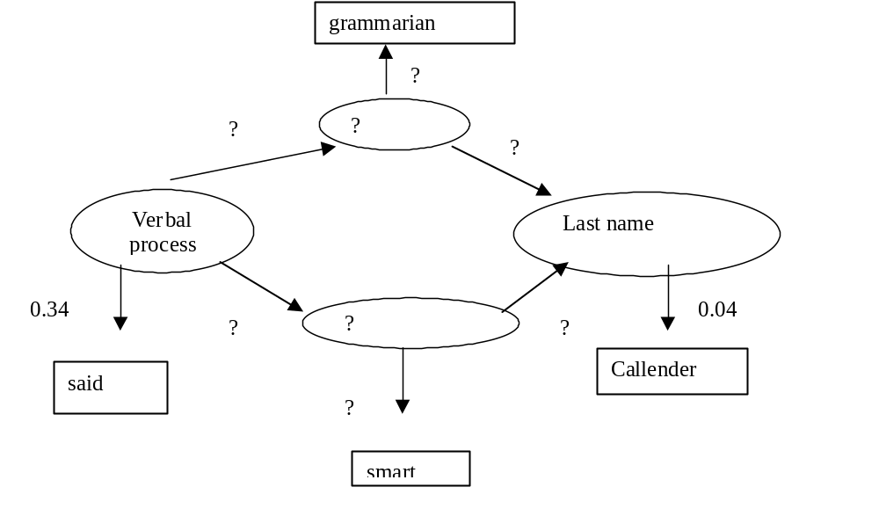

Slide 59
General setting
Information extraction: has received during decades a large interest because of its applicability to many types of information
In IR context: interest in IE from text is boosted by growing interest in IE in other media (e.g., images, audio)
Note: performance statistics given in this chapter are only indicative and refer to a particular setting (corpus, features used,classification algorithm, ...)

Slide 60
Overview
Generic versus domain-specific character of IE tasks
Possible applications:
  Processing of news texts
  Processing of biomedical texts
  Intelligence gathering
  Processing of business texts
  Processing of law texts
  Processing of informal texts

Slide 61
Overview
Specific case studies:
  Recognizing emotions expressed towards product or person (joint work with Erik Boiy)
  Recognizing actions and emotions performed or expressed by persons (joint work with Koen Deschacht)

Slide 62
Generic versus domain specific character
Generic information extraction and text mining: use of generic ontology or classification scheme
  Named entity recognition (person, location names, ...)
  Noun phrase coreference resolution
  Semantic frames and roles, ...
Domain-specific information extraction and text mining: use of ontology of domain-specific semantic labels
Techniques and algorithms are fairly generic

Slide 63
Processing news texts
Very traditional IE boosted by Message Understanding Conferences (MUC) in late 1980s and 1990s (DARPA), followed by Automatic Content Extraction (ACE) initiative and Text Analysis Competition (TAC) (NIST)
Tasks:
  Named entity recognition
  Noun phrase coference resolution
  Entity relation recognition
  Event recognition (who, what, where, when)

Slide 64
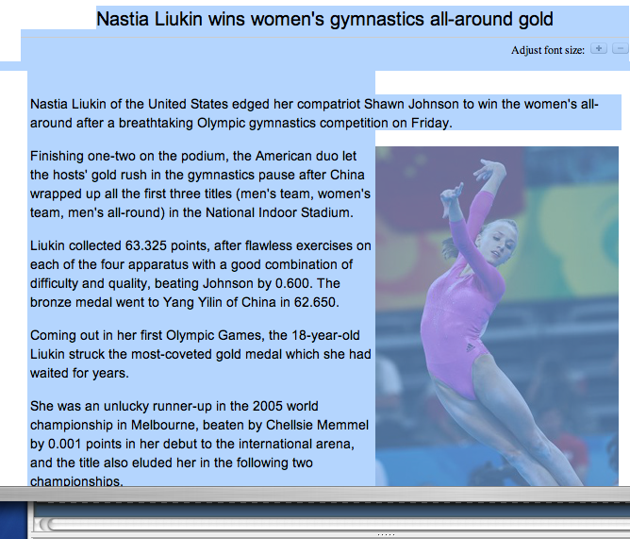
WHO?
WHEN?
WHAT?
WHERE?
www.china.org.cn

Slide 65
Processing news texts
Named entity recognition:
  Person, location, organization names
  Mostly supervised: Maxent, HMM, CRF
  Approaches human performance: in literature sometimes above 95% F₁ measure
[Bikel et al. ML1999] [Finkel et al. 2006]
Noun phrase coreference resolution:
  Although unsupervised (clustering), and semi-supervised (co-training), best results with supervised learning: F₁ measures of 70% and more are difficult to reach; also kernel methods
[Ng & Cardie ACL 2002] [Ng & Cardie HLT 2003] [Versley et al. COLING 2008]

Slide 66
Processing news texts
Entity relation recognition:
  use of supervised methods: e.g., kernel methods: F₁ measures fluctuate dependent on number of training examples and difficulty of the relational class (ambiguity of the features)
[Culotta & Sorensen ACL 2004] [Girju et al. CSL 2005]
Event recognition:
  in addition: recognition and resolution of:
    temporal expressions: TimeML
    spatial expressions: FrameNet and Propbank
[Pustejovsky et al. IWCS-5 2003] [Baker et al. COLING-ACL 1998] [Morarescu IJCAI 2007] [Palmer et al. CL 2005]

Slide 67
Processing news texts
Challenges:
  Cross-document, cross-language and cross-media (video !):
    named entity recognition and resolution
    event recognition:
      including cross document temporal and spatial resolution

Slide 68
Processing biomedical texts
Many ontologies or classification schemes and annotated databases are available:
    E.g., Kyoto Encyclopedia of Genes and Genomes, Gene Ontology, GENIA dataset
Tasks:
  Named entity recognition
  Relation recognition
  Location detection and resolution

Slide 69


Slide 70
Processing biomedical texts
Named entity recognition: difficult:
    boundary detection:
      capitalization patterns: often misleading
      many premodifiers or postmodifiers that are part or not of the entity (91 kDA protein, activated B cell lines)
    polysemous acronyms and terms: e.g., PA can stand for pseudomonas aeruginosa, pathology and pulmonary artery
    synonymous acronyms and terms
  Supervised context dependent classification: HMM, CRF: often F₁ measure between 65-85%
  [Zhang et al. BI 2004]

Slide 71
Processing biomedical texts
Entity relation recognition:
  Protein relation extraction
  Literature based gene expression analysis
  Determination of protein subcellular locations
  Pathway prediction (cf. event detection)
    methods relying on symbolic handcrafted rules, supervised (e.g., CRF) and unsupervised learning
  [Stapley et al. PSBC 2002] [Glenisson et al. SIGKDD explorations 2003] [Friedman et al. BI 2001] [Huang et al. BI 2004] [Gaizauskas et al. ICNLP workshop 2000]

Slide 72
Intelligence gathering
Evidence extraction and link discovery by police and intelligence forces from narrative reports, e-mails and other e-messages, Web pages, ...
Tasks:
  Named entity recognition, but also brands of cars, weapons
  Noun phrase coreference resolution, including strange aliases
  Entity attribute recognition
  Entity relation recognition
  Event recognition (recognition and resolution of temporal and spatial information; frequency information !)

Slide 73

www.kansascitypi.com

Slide 74
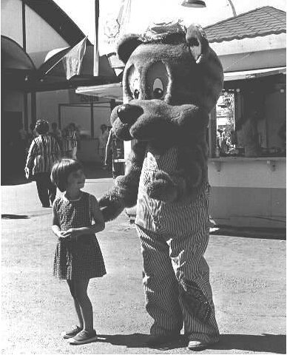

Intelligence gathering
See above news processing
Entity attribute recognition: often visual attributes, very little research;
  recognition of visual attributes in text based on association techniques (e.g., chi square) of word and textual description of image
African violets (Saintpaulia ionantha) are small,
flowering houseplants or greenhouse plants belonging
to the Gesneriaceae family. They are perhaps the most
popular and most widely grown houseplant.
Their thick, fuzzy leaves and abundant blooms in
soft tones of violet, purple, pink, and white make
them very attractive...
A small girl looks up at a person dressed in the costume of an anima
which could be "Woody Woodchuck" at the State Fair in Salem, Oregon.
[Boiy et al.TIR 2008]

Slide 75
Intelligence gathering
Challenges:
  Texts are not always well-formed (spelling and grammatical errors): drop in F₁ measures compared to standard language
  Often important to detect the single instance
  Combination with mining of other media (e.g., images, video)
  Recognition of temporal and spatial relationships, recognition of other rhetorical relationships (e.g., causal) [Hovy AI 1993] [Mann & Thompson TR 1997] [Mani 2000]
  Extracted information is often used to build social networks, which can be mined for interesting patterns

Slide 76
Processing business texts
Wealth of information can be found in technical documentation, product descriptions, contracts, patents, Web pages, financial and economical news, blogs and consumer discussions
Business intelligence (including competitive intelligence): mining of the above texts

Slide 77


traction.tractionsoftware.com
www.robmillard.com

Slide 78
Processing business texts
Tasks:
  Named entity recognition: including product brands
  Entity attributes: e.g., prices, properties
  Sentiment analysis and opinion mining

Slide 79
Processing law texts
Processing legislation, court decisions and legal doctrine
Tasks:
  Named entity recognition
  Noun phrase coreferent resolution
  Recognition of factors and issues
  Recognition of arguments
  Link mining
For a long time: low interest, but since 2007: TREC legal track (NIST)

Slide 80



Slide 81
Processing law texts
Recognition of factors and issues in cases:
  factor = a certain constellation of facts
  issue = a certain constellation of factors
Limited attempts to learn factor patterns from annotated examples based on a naive Bayes and decision tree learners
Difficulties:
  ordinary language combined with a typical legal vocabulary, syntax and semantics: making disambiguation, part-of-speech tagging and parsing less accurate
[Brüninghaus & Ashley 2001]

Slide 82
Processing law texts
Recognition of argumentation and its composing arguments in cases:
  an argument is composed of zero or more premises and a conclusion
  discourse structure analysis
Difficulties:
  see recognition of factors and issues
  discourse markers are ambiguous or absent
  argument are nested (conclusion of one argument is premise of another argument)
  difficult style: humans have difficulty to understand the content [Mochales Palau & Moens 2008]

Slide 83
Processing informal texts
Many texts diverge from standard language when created or when processed:
  Spam mail
  Blog texts
  Instant messages
  Transcribed speech
  ...

Slide 84
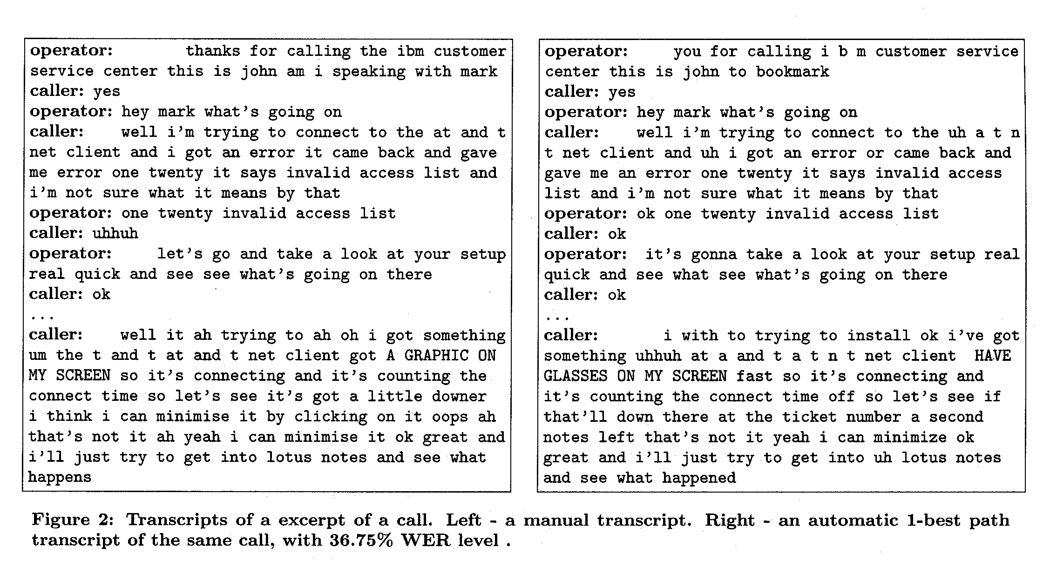
[Mamou et al. SIGIR 2006]
Source: Mamou et al. 2006

Slide 85
Processing informal texts
Accuracy of the extraction usually drops proportional with the amount of noise
Solutions:
  Preprocessing: e.g., most likely normalization based on string edit distances, language models
  Incorporating different hypotheses into the extraction process

Slide 86
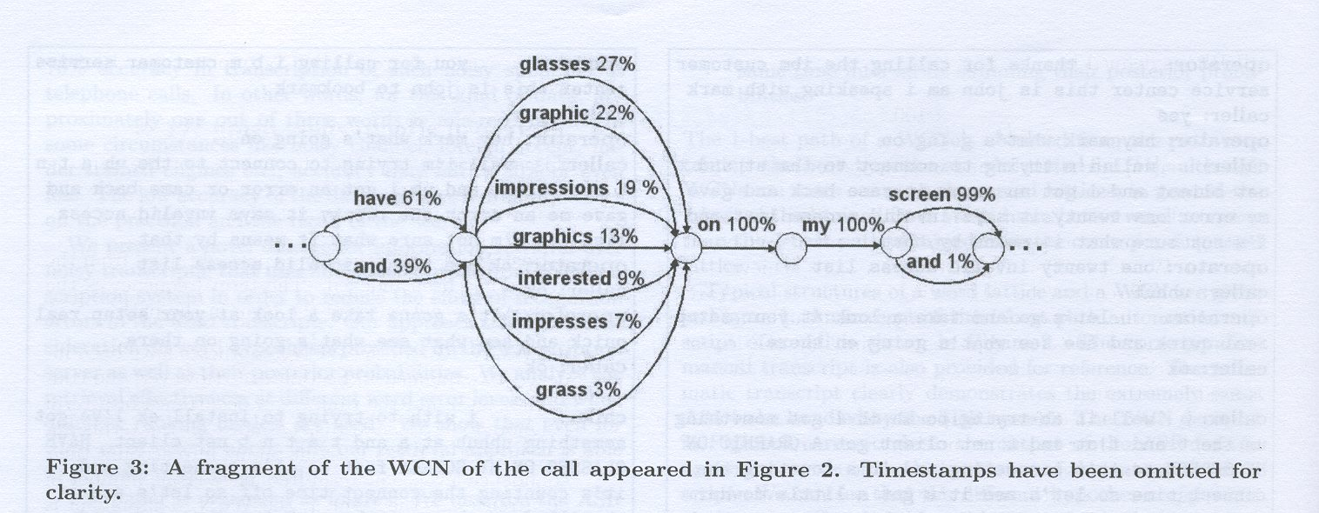
Processing informal texts
[Mamou et al. SIGIR 2006]

Slide 87
Case studies

Slide 88
Case 1: Emotion is expressed towards person or object
Solutions tested:
  Feature extraction
  Single classifier versus a cascaded classifier versus bagged classifiers
  Active learning
[Boiy & Moens IR 2008]

Slide 89
Case 1: Emotion is expressed towards person or object
Corpus:
  blogs: e.g., skyrock.com, lifejournal.com, xanga.cpm, blogspot.com; review sites: e.g., amazon.fr, ciao.fr, kieskeurig.nl; news fora: e.g., fok.nl, forums.automotive.com
  750 positive, 750 negative and 2500 neutral sentences for each language
  interannotator agreement: κ = 82%
Codes in the table below:
  SC uni: unigram features
  SC uni-lang: + language (negation, discourse) features
  SC uni-lan-dist: + distance in number of words with entity feature

Slide 90
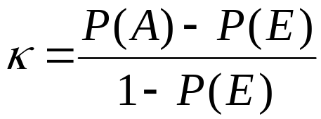
Inter-annotator agreement
Kappa statistic: agreement rate when creating ‘gold standard’ or ‘ground truth’ corrected for the rate of chance agreement
where
  P(A)= proportion of the annotations on which the annotators agree
  P(E) = proportion of the annotations on which annotations would agree by chance
κ > 0.8: good agreement
0.67 <= κ <=0.8: fair agreement
More than 2 judges: compute average pairwise κ

Slide 91
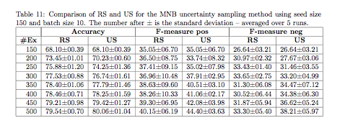
Case 1: Emotion is expressed towards person or object
Active learning techniques tested on English corpus:
  Uncertainty sampling (US): to find informative examples
  Relevance sampling (RS): to find more negative examples
  Combination of US and RS yielded best results:

Slide 92
Case 2: Person performs action or expresses emotion
Semantic role labeling:
Recognizing the basic event structure of a sentence (“who” “does what” “to whom/what” “when” “where” ...): semantic roles that form a semantic frame
  Maria Sharapova walks towards the field.
  x₁ x₂ x₃ x₄
  y₁ y₂ y₃ y₄
  actor movementAction toLocation toLocation

Slide 93

CLASS (EU: 2006-2008)
Source: Buffy
Text of script: 51: Shot of Buffy opening the refrigerator and taking out a carton of milk.

Slide 94
Case 2: Person performs action or expresses emotion
Classification of semantic frames in text: validation of 353 sentences (1 episode) from transcripts of fans of “Buffy the Vampire Slayer” (trained on 7 episodes)
Evaluation of several classification models:
  Supervised learning:
    HMM
    CRF
  Semi-supervised: learning from unlabeled examples: learning of multiple mixture models, inference based on expectation maximization, approximate inference (Markov chain Monte Carlo sampling methods)
[Deschacht & Moens Technical Report 2008]

Slide 95
Case 2: Person performs action or expresses emotion
Problem:
  large number of patterns that signal a semantic frame/role
  relies on sentence parse features which might be erroneous
Results might be improved by sentence simplification techniques:
  application of a series of hand-written rules for syntactic transformation of the sentence, where the weights of the rules and the SRL model is learned
  [Vickrey & Koller ACL 2008]

Slide 96
Conclusions
Use of current information extraction technologies yield valuable input for:
  Automatic search and linking of information
  Automatic mining of extracted information
But also can offer a competitive advantage for businesses:
  Knowledge on competitors’ products, prices, contacts, ...
  Knowledge of consumers’ attitudes about products, ...
  ...
But not always transparent what kind of information can be found, linked, inferred, ...
So, be careful what you write ...

